Slide 1

Spice
Team 3: Julia Rose Chin, Britney Ky, Dylan Ly, Ji Hong Ni

Slide 2

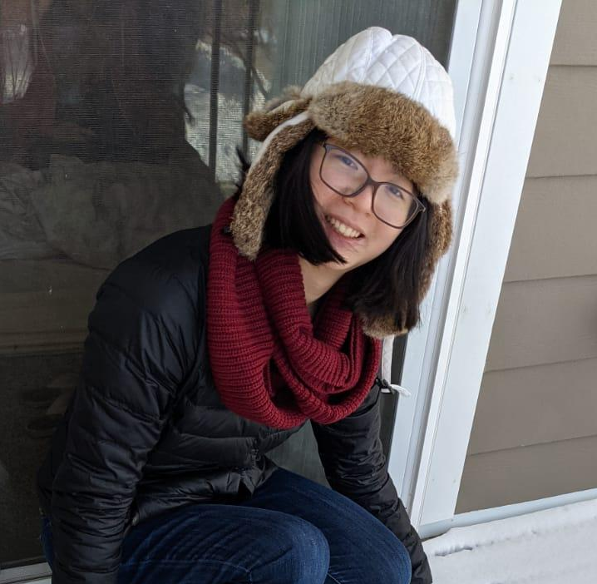
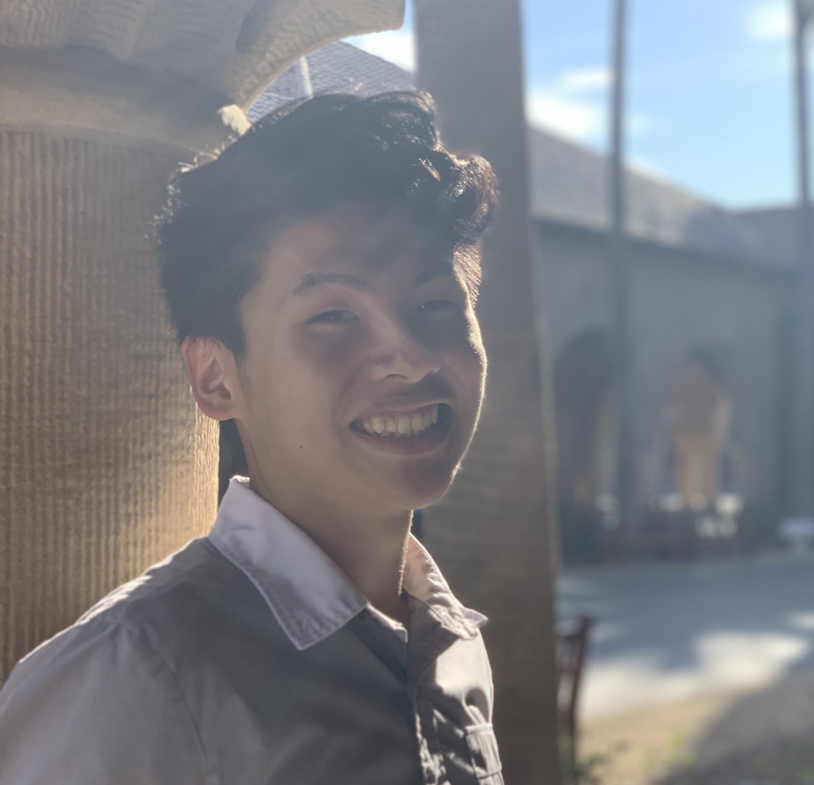

Meet the Team
Britney K.
Julia C.
Ji Hong N.
Dylan L.

Slide 3
Overview
Where we started
What we did
Now what?

Slide 4
Mission Statement
With Spice, our vision is to make cooking fun, social, and accessible for busy college students. Spice will assist you throughout your entire cooking journey by providing simple tips, tasks, and community interactions. We’ll elevate both your experience and meal – so let’s get creative in the kitchen!

Slide 5
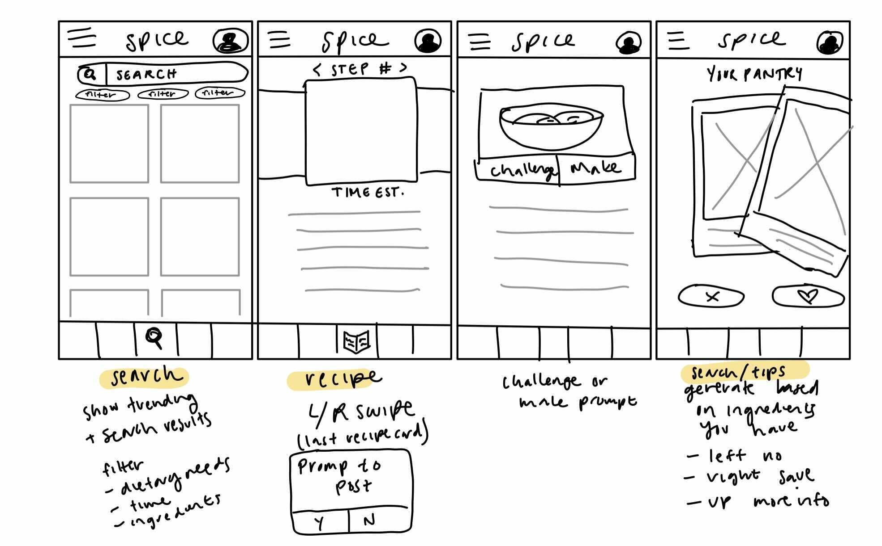
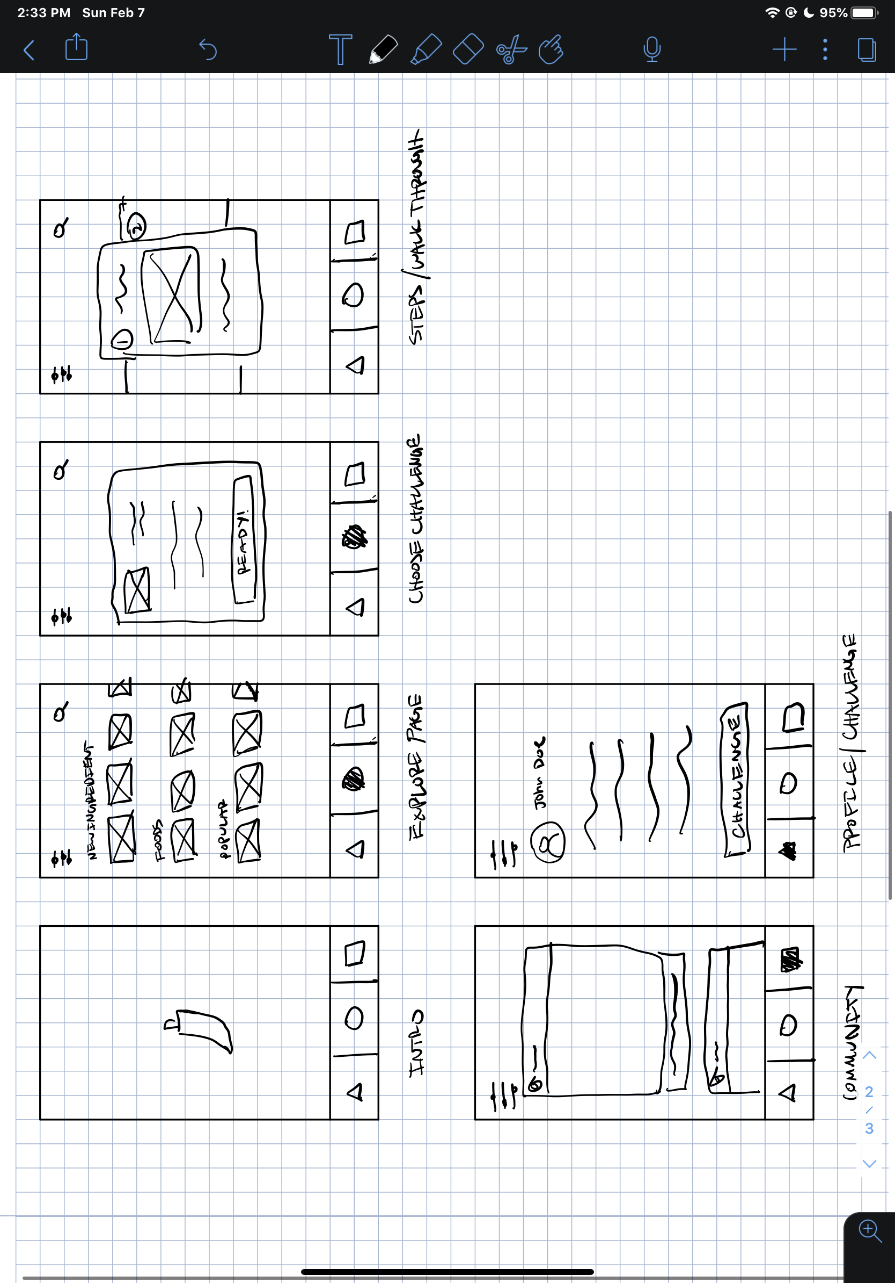
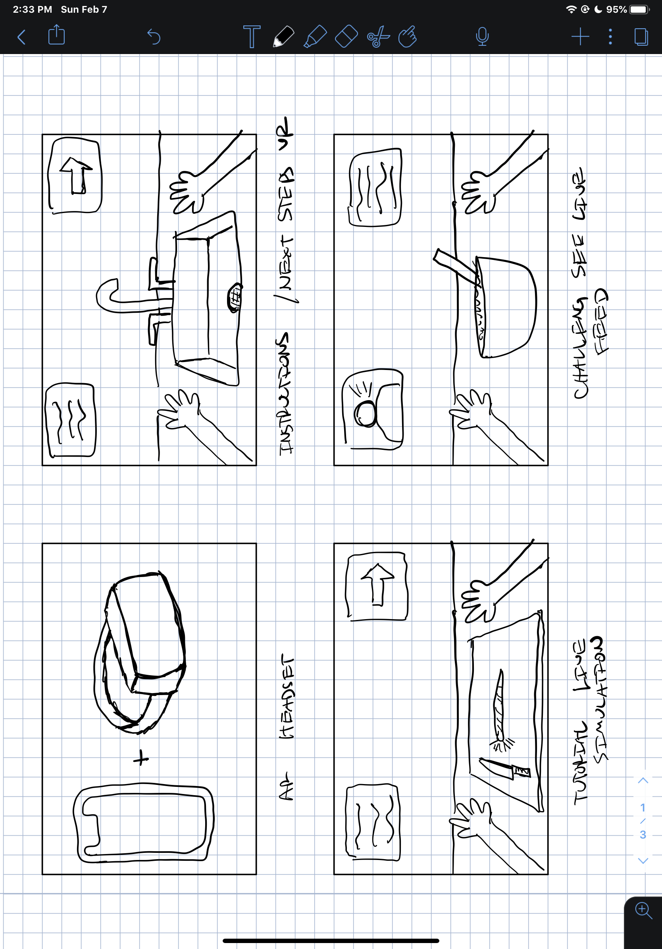
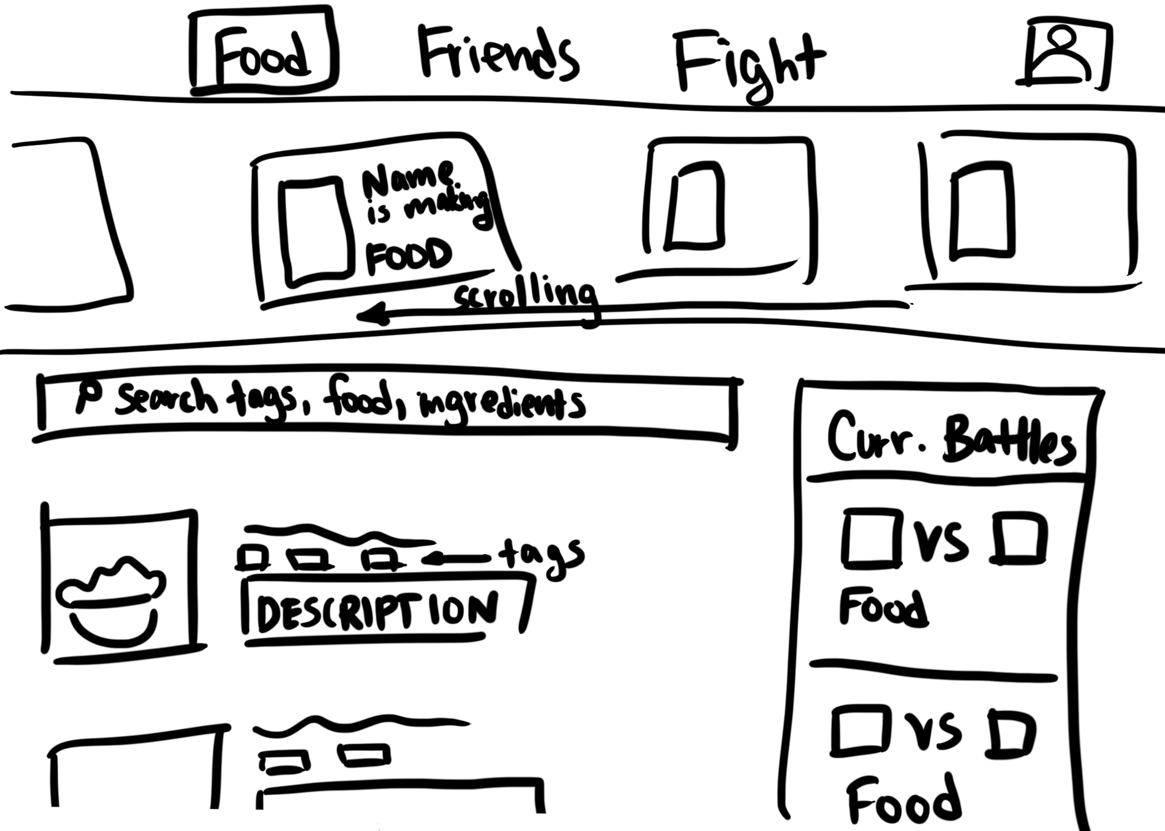
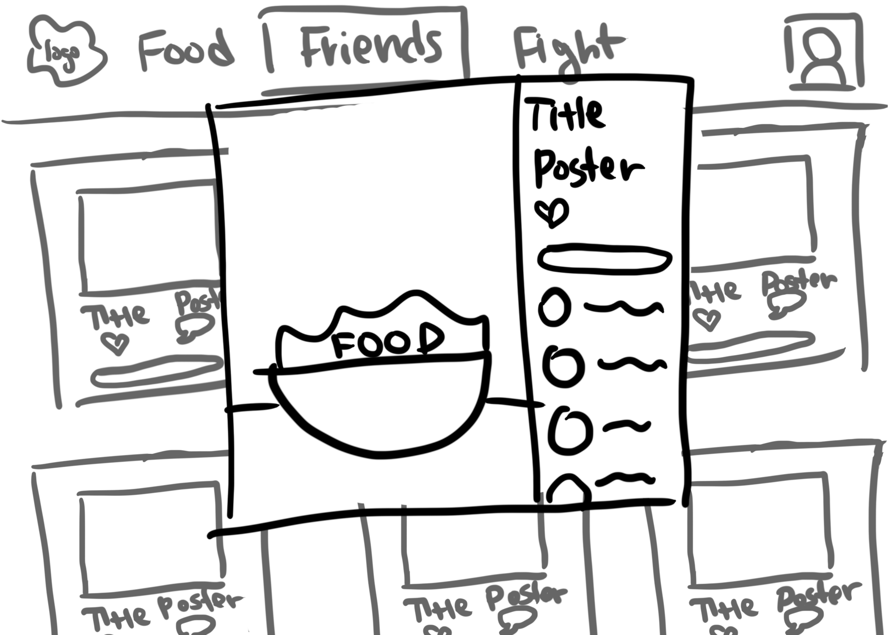
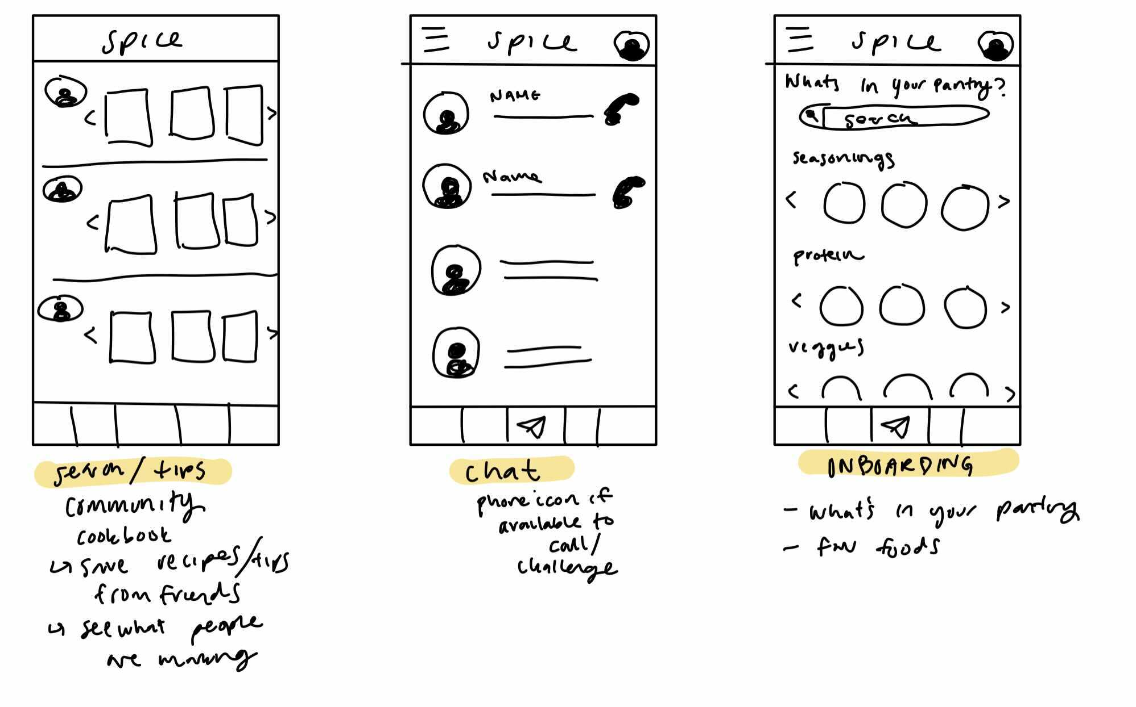
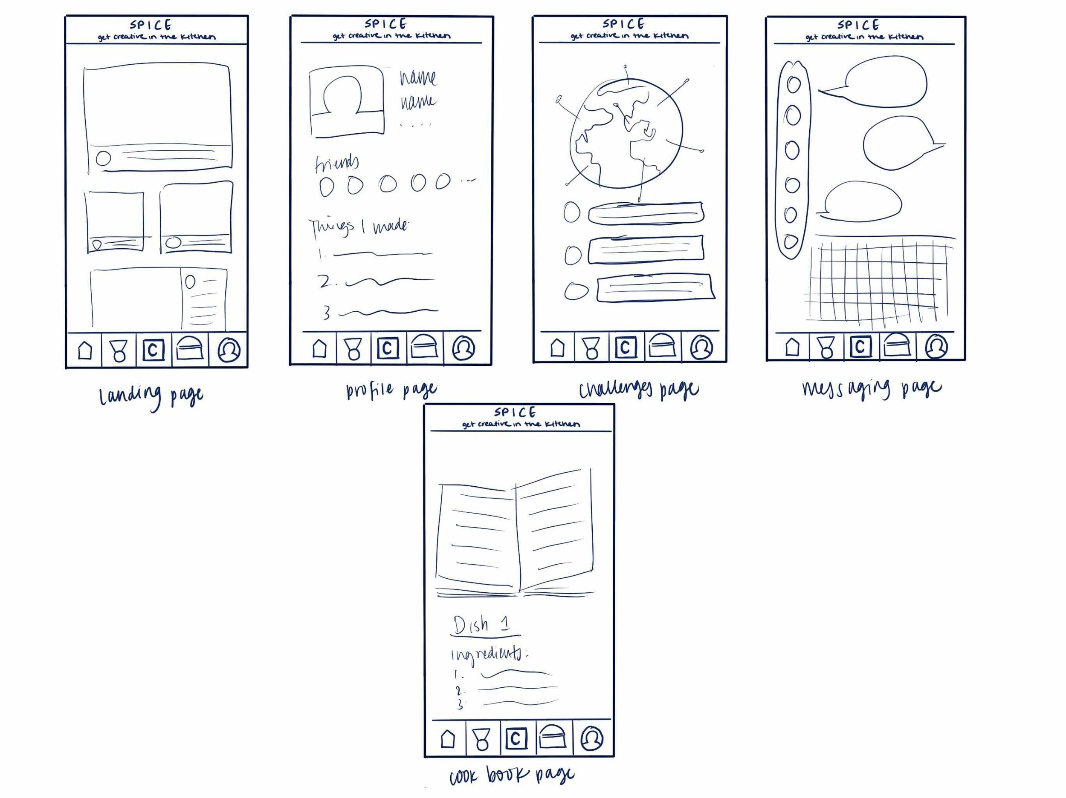
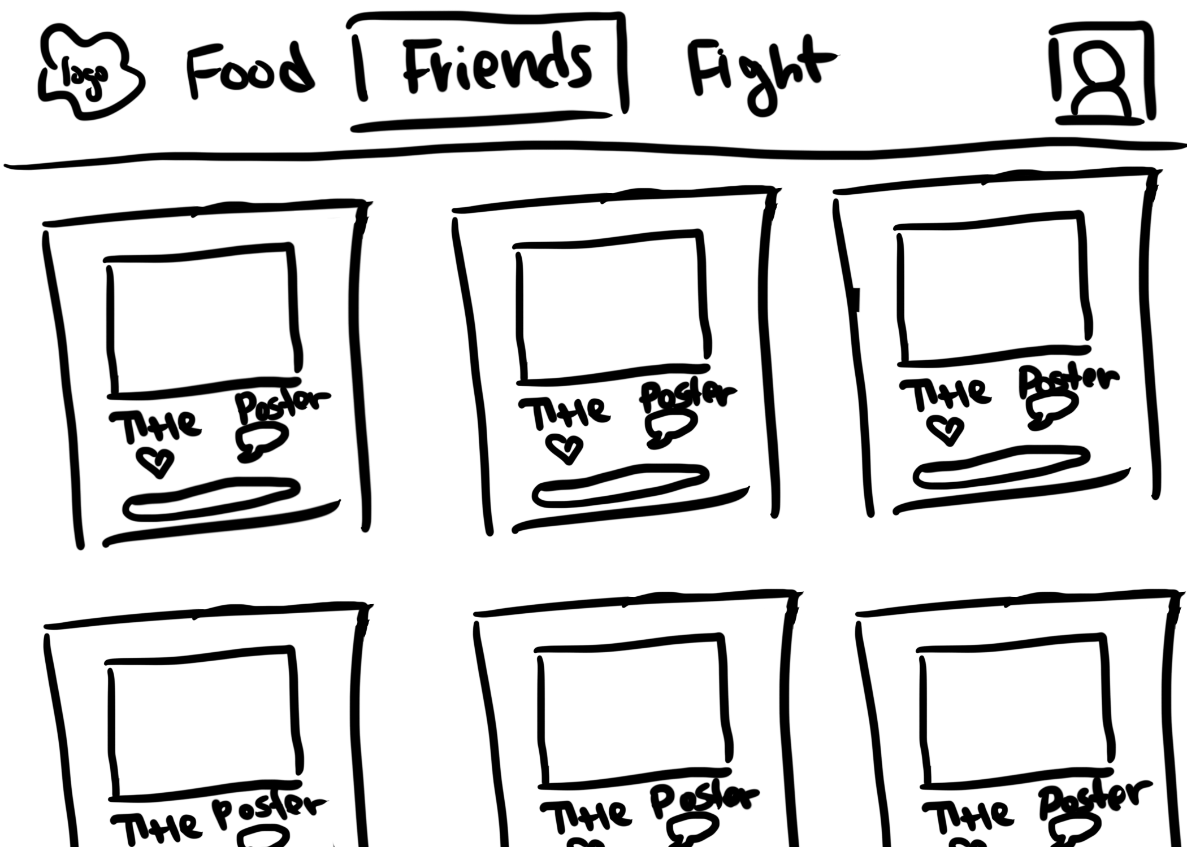
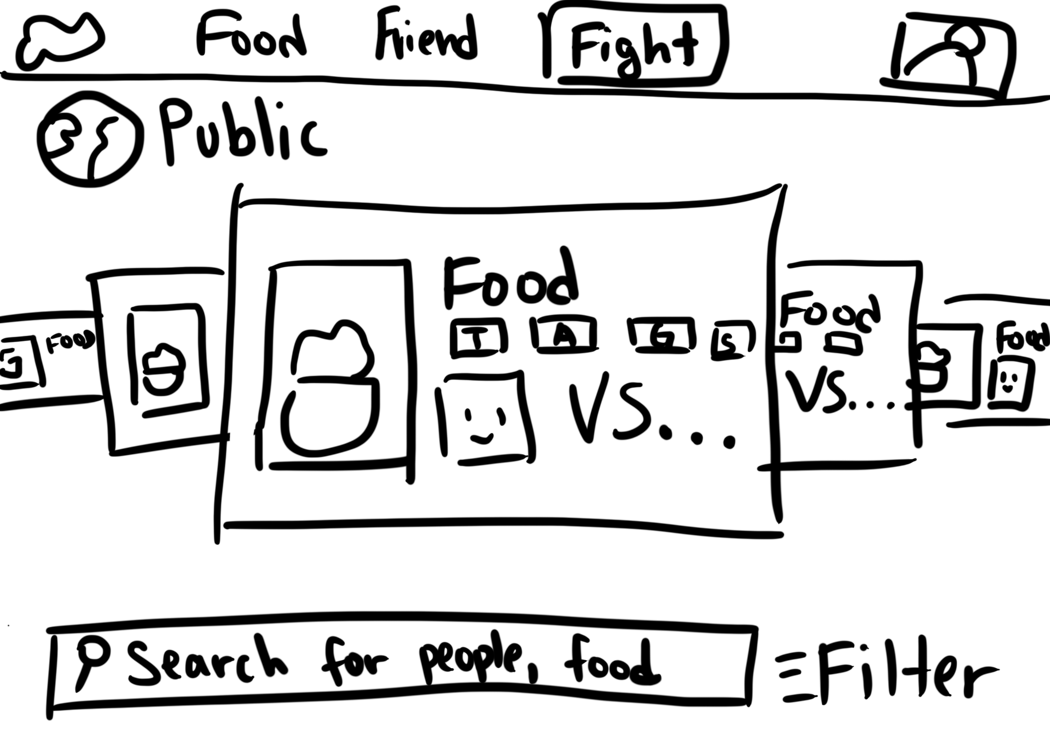
Concept Sketches
VR/AR interface
mobile interface
website interface
Notes:
Tried a series of interfaces:
AR/VR: Using a VR headset to guide users through the cooking process
adding animations and such to make the process more fun
Live simulations and tutorials for less experienced cooks
Video chatting in one of the corners to achieve task 3
Allows user to interact with UI and physical world at the same time
Negative: could potentially be dangerous with knife work and a headset on?
Website interface:
Less cluttered, more simplified since the screen is larger
Negative: Difficult because likelihood of using a computer in the kitchen is lower
Positive: Most college students would have access to some type of computer making this medium accessible

Slide 7
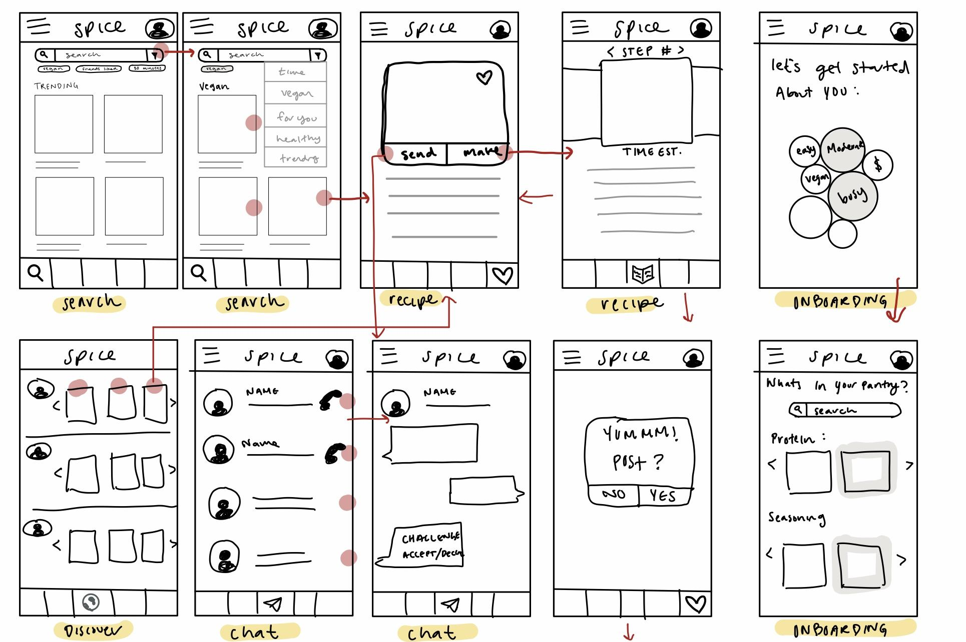
UI Sketch One
Mobile Interface
Explore page
Recipe walk through
Community board
Messaging
Notes:
Mobile Interface detailing different screens and their storyboard
This interface specifically:
Tasks are nestled within each other to create ease of access when doing different tasks
In app Messaging screen
Card swipe through to guide user through digestible steps of a recipe

Slide 8
UI Sketch One - Why Mobile?
Pros:
Cons:
An app and phones are more accessible for our target audience - the average college student
VR technology is not as widely used as mobile phones/ apps
Research found that a lot of people already use their phones to search for recipes and such so this brings familiarity
Not as interactive as VR
Occupied hands while cooking makes interacting with a screen more difficult
Can not instruct movement as well as wearable tech

Slide 9
UI Sketch One - Mobile
Pros:
Cons:
Mobile interface is more accessible
User experience for Task 1 from start to finish has few screens
Explicit action buttons
Achieves main functionality simplistically
Having both hamburger menu and bottom navigation is confusing
Has to navigate through Task 1 to do Task 2 and 3

Slide 10
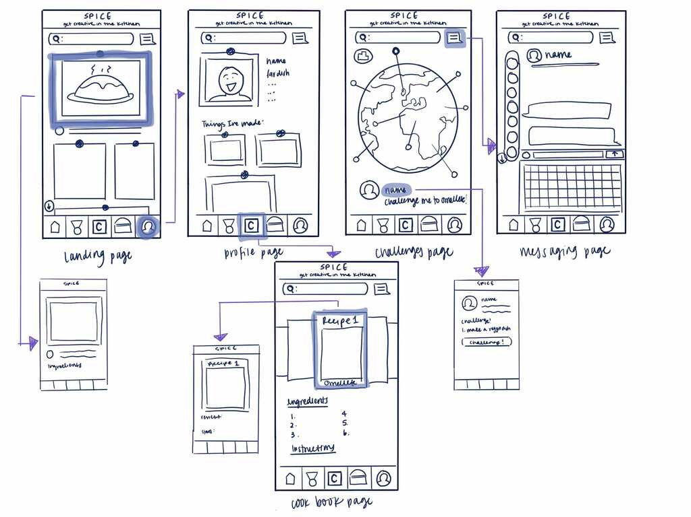
UI Sketch Two
Mobile Interface
Global Influence
Recipe walkthrough
Messaging
Profile
Explore page
Notes:
This interface specifically:
Screen with globe to visualize exploration more explicitly
Emphasis on a profile and building a profile specific to the user
Card swipe through to help guide users through the entire recipe

Slide 11
UI Sketch Two - Why Mobile?
Pros:
Cons:
Community aspect better emphasized with mobile interface
Accessibility
Familiarity since most people use their phones when researching food
Not as immersive experience as VR
VR links digital/physical space more directly
Wearable technology is more physical than a mobile app

Slide 12
UI Sketch Two - Mobile
Pros:
Cons:
Mobile interface is more accessible
Globe is eye-catching
Dynamic grid layout
Emphasis on graphics
Clear bottom navigation bar
Potentially unclear purpose
Search bar always expanded
Unclear task flow and icons

Slide 13
Design Rationale
UI Sketch One
Achieves tasks more clearly
A more simple UI
Familiarity in UI layout
A more seamless UX between tasks
Notes:
Why this UI?
A more seamless UX between tasks
Going from one task to another requires minimal user effort since they are nestled within each other at multiple steps
Tasks themselves are more streamlined -> less screens to accomplish a single task
Users noticed other features and tasks while completing a different one -> exposure to different features of the app creates the hope that people return since they see all the features
UI choices
Buttons were large, simple, and clear
Clear buttons/clickables -> easier for the user to figure out the different tasks
Novel Features:
Social/community integrated throughout cooking experience
Prompts to challenge/post within start and end of recipe cards
Exposes users to possibility of creating a sense of community while cooking
Voice controlled recipe guidance
Breaks recipes down to digestible steps for cooks of all levels
No need to pause/play videos, click screen to move on to next step, etc -> voice control interactivity to minimize use of hands that are likely occupied while cooking
No need to memorize steps in a video or read an article for a recipe -> step by step helper to guide through the process and save the most time
Feature to adapt/improve dishes you already know
More friendly to users with less cooking experience since there are filters for these users
Option to slightly adapt existing dishes rather than invest time making entirely new dishes (for users with limited experience / time)

Slide 14
Low-Fi
Prototype

Slide 15
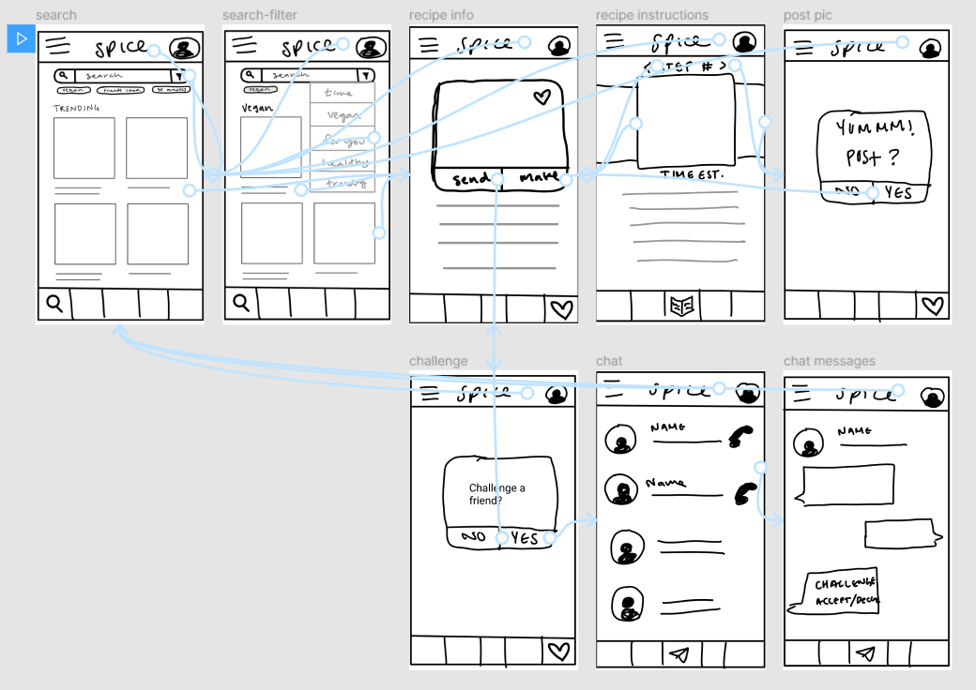
Prototype Structure

Slide 16
Task Flows

Slide 17
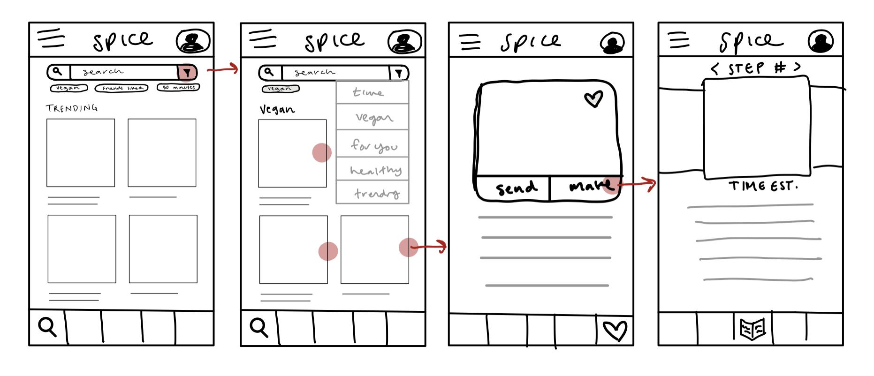
Task One: You have been making bland/repetitive food for some time now and want to spice up your cooking. Navigate the app to find a way to spice up your food!

Slide 18
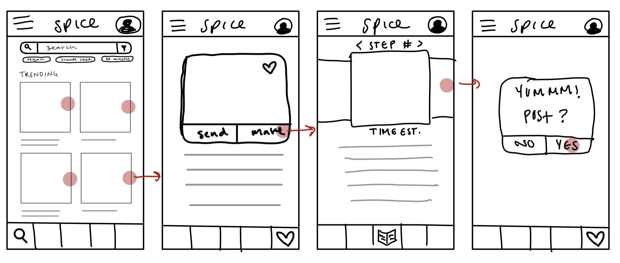
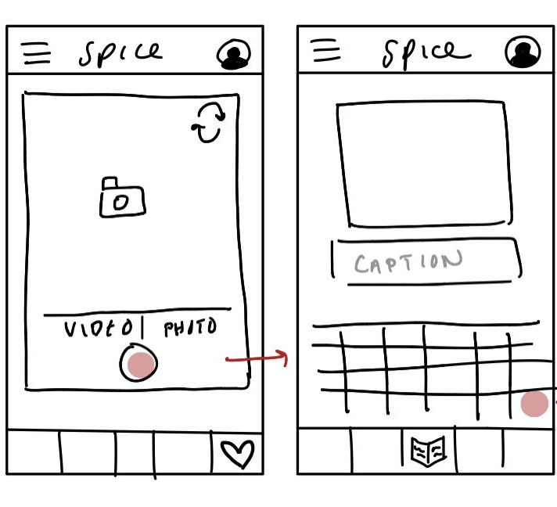
Task Two: You just finished making your new dish and want to show it off. Navigate the app to find a way to share your creation with your friends/community!

Slide 19
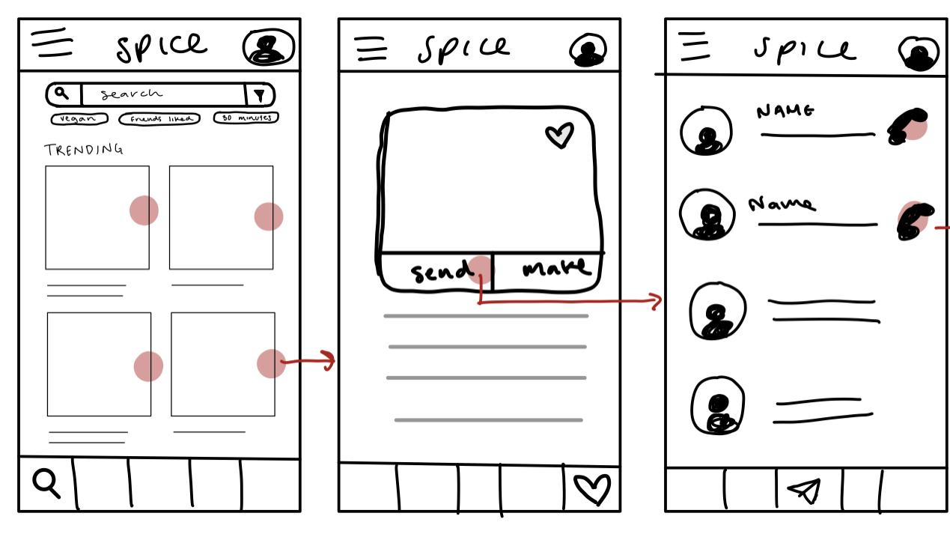
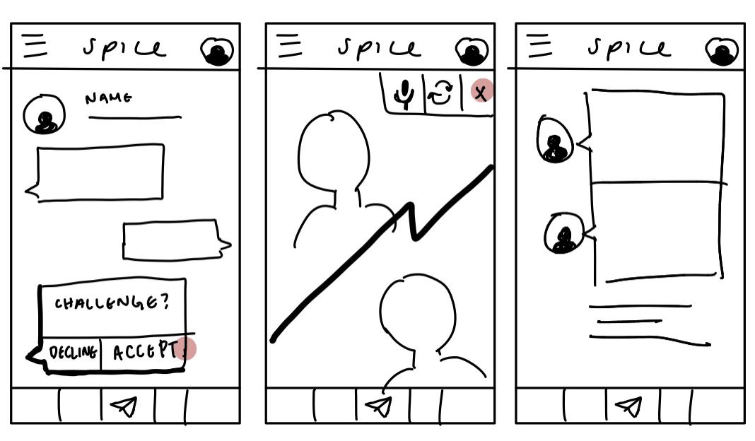
Task Three: You have found something cool to make and want to make it with a friend. Navigate the app to find a way to cook with a friend!

Slide 20
User Testing

Slide 21

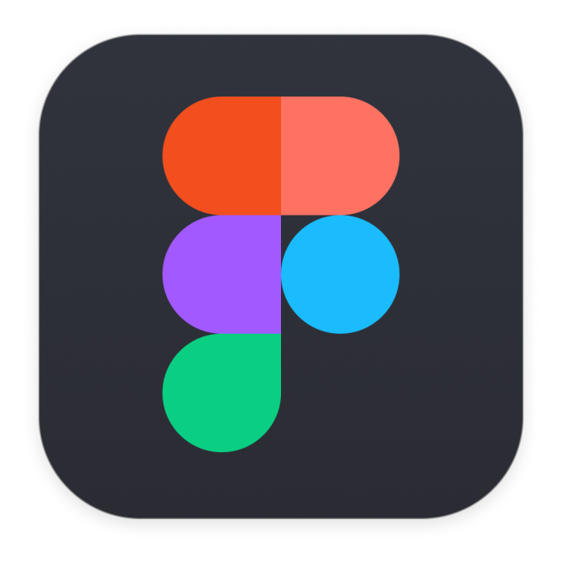

Methods
Recruitment: Discord servers asking for college students to test an app. Selected participants of varying levels of cooking ability.
Environment: Figma prototype, Zoom shared screen
Roles: Greeter/Facilitator, Notetaker (rotated between roles)
Notes:
Recruitment:
Wanted random users in our target audience so outsourced to a wide group of people
Zoom:
Asked to screen share throughout the prototype process to observe mouse movement and clicks

Slide 22



Methods
Summary:
Quick demo of Figma
Put forth 3 different scenarios for the 3 tasks (1 at a time)
Asked participants to navigate through the app to accomplish those various tasks
Observations: Body language, mouse movement, clicking, verbal descriptions
Notes:
Things we looked out for:
Mouse hovering over a certain area
Excessive clicks without any change in screen
Hesitation when clicking
Going back and forth between screens
Audio cues like “umm” and “hmm” to indicate confusion

Slide 23
User One: Kevin
Positive:
Negative:
Mobile interface is more accessible
Enjoyed exploring filters
General dish overview was helpful
Liked the interface that guided user through steps of a recipe
Instinctually go to hamburger menu when we didn’t want that
“Post” implied outsourcing to a different platform
Terminology used was confusing
Did not finish completing Task 3
Notes:
Post implied outsourcing to a different platform
User expected pop up to other sites like FB or IG when clicking on Post
Did not think that functionality was within the app itself
Assumed the app was just one to guide through recipes
Did not finish completing task 3:
Navigated to screen where there was a “send” option and implied that upon clicking that, a the default phone method for sharing would appear
Did not think that sharing meant sharing to others within the app itself
Thought it was sharing to external sites and not to others within the community of the app

Slide 24
User One: Kevin
Insights:
Choose between a hamburger menu or bottom navigation bar
Achieve tasks without having to go through other tasks
With pictures (more medium fi), there would have been less confusion

Slide 25
User Two: Kimberly
Positive:
Negative:
After some navigation with the app, she accomplished task 3 pretty fast
Trending page is good for looking for inspirations
Similar posting mechanism to Instagram
Talked through her approach to but didn’t actually go to the page we wanted her too
Tried to click on the profile button
Unsure what the make button does
Sending dishes/sharing takes a lot of clicks to accomplish

Slide 26
User Two: Kimberly
Insights:
Too many clicks to accomplish some of the tasks
Simplify navigation bar + profile button
Goal of a user profile in this type of app
Notes:
Kimberly only mentioned her annoyance with the time needed to accomplish the task at the end when we asked her for overall thoughts

Slide 27
User Three: Ivi
Positive:
Negative:
Task with sharing was clear and simple compared to other apps
Nice font size/ placement
Being able to explore filters
Enjoyed home screen layout with large pictures with comfortable spacing
Wanted more streamlined filters
Did not end up navigating to the correct task 1 page
Associated photos/ posting with FB and IG
Always clicked nav bar when asked to complete a new task

Slide 28
User Three: Ivi
Insights:
User-uploaded photos for the recipes would make cooking less daunting
A specific filter on cooking ability
Clarifying navigation bar
Notes:
Issue with Posting:
Users were not aware of the community aspect of the app
There was nothing in the nav bar or menu that suggested a type of forum with other people posting their creations
This then led “post” to seem as if it was on a 3rd party site since they did not think our app had that functionality
Too many intermediate steps to get to the post step also made it seem as if the task was completed and then it was time to share with others not on the app.

Slide 29
UI Changes

Slide 30
Potential Improvements
Clarifying the means of navigation (having one way to navigate)
Make robust filters
Create multiple avenues to start and complete tasks
Clarify terminology
“Posting” / “Send” / “Challenge”
Clarifying user profile purpose

Slide 31
Summary
Decided on a mobile interface
Conducted user prototype testing
Discovered profound insights with NavBar, filters, and Task UX
Moving Forward:
Refine UI
Simplify UX of individual tasks
Implement more functionality

Slide 32
Thank you!
Questions?

Slide 33
Appendix

Slide 34
Figma Prototype
https://www.figma.com/proto/uFBib6N6XdHTJxmthJPpa8/Low-Fi-Prototypes?scaling=scale-down&node-id=2%3A3

